Slide 1
Epidemiology and Big Data Mixed Models part 3: Technical issues in multilevel/longitudinal modelling
Rebecca Stellato

Slide 2
Overview Part 3: technical issues in mixed models
Choosing a model
LRT/AIC
REML vs ML estimation in mixed models
A model building strategy for MM
Testing random effects (variances)
Testing fixed effects
Checking assumptions of the model
Effect of centering explanatory variables
Polynomials in linear mixed models
More than 2 levels

Slide 3
Reisby example, revisited
Hamilton Depression Rating Score on 66 patients measured at 6 time points
hdrs.0 hdrs.1 hdrs.2 hdrs.3 hdrs.4 hdrs.5
hdrs.0 1.000 0.493 0.410 0.333 0.227 0.184
hdrs.1 0.493 1.000 0.494 0.412 0.308 0.218
hdrs.2 0.410 0.494 1.000 0.738 0.669 0.461
hdrs.3 0.333 0.412 0.738 1.000 0.817 0.568
hdrs.4 0.227 0.308 0.669 0.817 1.000 0.654
hdrs.5 0.184 0.218 0.461 0.568 0.654 1.000

Slide 4
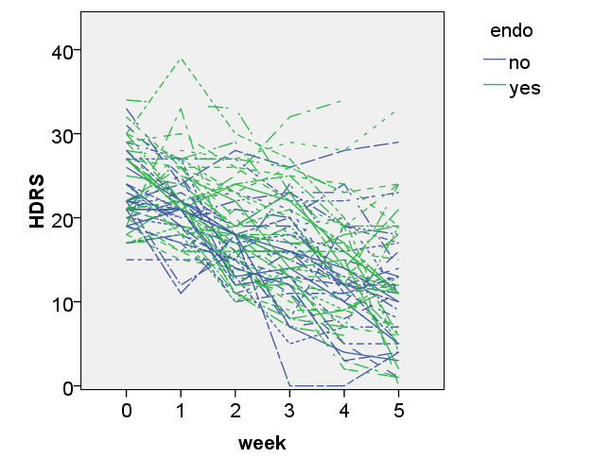
Reisby example, revisited

Slide 5
Reisby example, revisited
We talked about several logical models to fit the variance-covariance matrix of the HDRS scores over time...
CPM with heteregeneous AR(1) correlation structure
CPM with unstructured correlation structure
LME with random intercept + slope (for time)
...and several less logical models:
CPM with identity correlation structure
CPM with compound symmetry/LME with random intercept
CPM with homogeneous AR(1) correlation structure

Slide 6
Testing in Linear Mixed Models
To decide which LMM fits the data best we can use likelihood- based methods:
Likelihood Ratio Test (LRT)
LRT can be used to test nested models (one is a special case of the other)
based on the χ²-distribution
Akaikes Information Criterium (AIC)
combination of likelihood and # parameters used in the model (d.f.)
model with the lowest AIC (high likelihood with few parameters) is deemed best

Slide 7
(Restricted) Maximum Likelihood Estimation
Mixed models: maximum likelihood used to estimate fixed regression coefficients and variances of random effects
likelihood quite complex, solved by iteration until convergence
(Empirical Bayes methods used to estimate individual random effects)
Problem with ML estimation:
variance parameters (residual variance, variance(s) of random effect(s)) biased downwards
Solution: REstricted (or: REsidual) Maximum Likelihood (REML)
gives unbiased estimates of variance parameters
BUT: adjusts likelihood for number of covariates in model, so cannot be used to compare models that differ w.r.t. fixed parts of model

Slide 8
When to use ML, REML?
Testing models that differ in variance components:
REML will give interpretable LRT, AIC
so will ML
Testing models that differ in fixed effects:
only ML will give interpretable LRT, AIC
Reporting results (esp if you include the random components):
use REML!

Slide 9
When to use ML, REML?
Leading me to suggest the following model-building strategy:
Start with full fixed model and (using ML estimation), select appropriate random part of model
With the random part chosen, (using ML estimation) try to reduce fixed part of model
Once you have your final model: run that model once more using REML; this is the model you present to your audience
Testing random effect(s):
variance parameters are never <0
LRT (REML/ML) for random effects: chi-square test, but divide p-value by 2
AIC also okay (but please: no AIC + 2)
Testing fixed effect(s):
LRT (ML only!) for fixed effects: chi-square test, usual p-value
AIC okay (only under ML)

Slide 10
Reisby example, comparing correlation structures
Four models with the same fixed structure (endo*week, 12 degrees of freedom) and different random parts.
Compare these using ML-based methods (LRT and / or AIC):
Model | # cov par | -2*logLike | AIC
Identity | 1 | 2388.027 | 2414.027
Comp Symm | 2 | 2277.381 | 2305.381
Unstructured | 21 | 2183.227 | 2249.227
AR(1) homogen | 2 | 2221.847 | 2249.847
AR(1) heterogen | 7 | 2207.462 | 2245.462

Slide 11
Reisby example, comparing correlation structures
From the comparison of the AIC’s
Taking dependence into account greatly improves the model fit
Assuming equal variances and equal correlations is not a good option for these data
The parsimonious homog. AR(1) not worse than unstructured
The AR(1) with heterogeneous variances is best
We could also have used LRTs (for nested models only), with corrected p-values:
Homogeneous vs heterogeneous AR(1) (for instance):
LRT = 2221.847 -2207.462 = 14.385 with 7-2= 5 df; p = 0.0133/2 = 0.0067
heterogeneous is significantly better than homogeneous AR(1)

Slide 12
Reisby example, comparing correlation structures
We can also compare LMEs with *linear* time trend with one another:
fixed: time, endo, time*endo
random: intercept vs. int+slope
> anova(lme.ris, lme.ril)
Model df AIC BIC logLik Test L.Ratio p-value
lme.ris 1 8 2230.929 2262.345 -1107.465
lme.ril 2 6 2294.137 2317.699 -1141.069 1 vs 2 67.20798 <.0001
Model with rand int+slope is better than rand int only (LRT or AIC)

Slide 13
Reisby example, comparing correlation structures
No LRT to compare LMEs with linear time trend to models with CPM
But we can use AIC to compare these non-nested models
Model | AIC
CPM Unstructured | 2249.227
CPM AR(1) heterogen | 2245.462
LME rand int + slope | 2230.929
Model with rand int+slope is best according to AIC

Slide 14
Reisby example, fixed part of the model
Now we have the random structure, we’ll look at the fixed part of the model
Three possibilities:
only time
endo + time
endo*time (both main effects + interaction)
We use ML estimation for testing the fixed part of the model

Slide 15
Reisby example, fixed part of the model
> lme2.ris<-update(lme.ris, fixed=hdrs ~ time+endo)
> lme3.ris<-update(lme.ris, fixed=hdrs ~ time)
> anova(lme.ris, lme2.ris, lme3.ris)
Model df AIC BIC logLik Test L.Ratio p-value
lme.ris 1 8 2230.929 2262.345 -1107.465
lme2.ris 2 7 2228.933 2256.422 -1107.467 1 vs 2 0.004160 0.9486
lme3.ris 3 6 2231.037 2254.599 -1109.519 2 vs 3 4.104108 0.0428
interaction not significant: no evidence that time effect differs for the groups
effect of endo (just) significant: evidence for (small) difference between depression scores of people with and without endogenous depression

Slide 16
Reisby example, final model with REML
> lme3.ris.reml <- update(lme2.ris.CAR1, method="REML")
> summary(lme2.ris.reml)
Linear mixed-effects model fit by REML
Data: reisby.long
AIC BIC logLik
2228.116 2255.548 -1107.058
Random effects:
Formula: ~time | id
Structure: General positive-definite, Log-Cholesky parametrization
StdDev Corr
(Intercept) 3.490342 (Intr)
time 1.457808 -0.287
Residual 3.494719

Slide 17
Reisby example, final model (cont.)
Fixed effects: hdrs ~ time + endo
Value Std.Error DF t-value p-value
(Intercept) 22.492881 0.7598098 308 29.603306 0.0000
time -2.380472 0.2103154 308 -11.318581 0.0000
endo 1.956867 0.9658720 64 2.026011 0.0469
Correlation:
(Intr) time
time -0.318
endo -0.704 -0.008
Standardized Within-Group Residuals:
Min Q1 Med Q3 Max
-2.73520482 -0.49503123 0.03559898 0.49317021 3.62063687
Number of Observations: 375
Number of Groups: 66

Slide 18
Reisby example, final model (cont.)
> intervals(lme2.ris.reml)
Approximate 95% confidence intervals
Fixed effects:
lower est. upper
(Intercept) 20.99780674 22.492881 23.987956
time -2.79430883 -2.380472 -1.966635
endo 0.02731607 1.956867 3.886418
attr(,"label")
[1] "Fixed effects:"
Random Effects:
Level: id
lower est. upper
sd((Intercept)) 2.6340279 3.4903416 4.62503996
sd(time) 1.1419605 1.4578084 1.86101482
cor((Intercept),time) -0.5695496 -0.2870567 0.05608577
Within-group standard error:
lower est. upper
3.194723 3.494719 3.822884

Slide 19
“Clinical” conclusions imipramine example
There was no significant interaction between time and group
time trends same for patients with endogenous and exogenous depression: the lines run parallel
There was a significant main effect for group
at any given point in time, patients with endogenous depression have HDRS scores on average 1.96 (95% CI: 0.03 – 3.89) points higher than those without
The effect of time is statistically significant
For patients with both endogenous and exogenous depression, HDRS scores decrease, on average, by 2.4 (95% CI: 2.0 - 2.8) points per week
On average 5*2.33 = 11.9 points in the course of the study
Am & Eur guidelines suggest that a 3-point change is clinically relevant
Before presenting these results, we need to check our model assumptions!

Slide 20
Checking assumptions of the model
Model assumptions:
linearity (if we use time – or other covariates – as linear)
check with individual plots, spaghetti plots, residual plots
normality of residuals
normality of random intercepts (& slopes, if used)
these three can be saved and checked using Q-Q plots, boxplots, histograms
but: generally not helpful
because deviations from normality probably not a big problem for inference on fixed effects (if your interest is in inference on random effects, there could be a problem)
model ‘inflicts’ normality on the random effects, so normality of the estimated random effects may partly reflect model assumptions
independence of residuals (once fixed and random effects are taken into account)
as in linear models: keep your fingers crossed!

Slide 21
Checking assumptions of the model in R
Diagnostic plots for (level-1) residuals: Q-Q plot of residuals
Aside from three outliers, no departures from normality

Slide 22
Checking assumptions of the model in R
Diagnostic plots for (level-1) residuals: residuals vs. fitted
(We’re hoping for a graph with no patterns)
This looks a bit problematic: a slight trend towards higher residuals with higher fitted values
Problems with linearity and/or missing covariates?

Slide 23
Checking assumptions of the model in R
Diagnostic plots for (level-1) residuals: residuals vs. fitted by endo
The problems we saw in the whole sample are present in both groups

Slide 24
Checking assumptions of the model in R
Boxplots residuals per subject
We can use this plot to check for large outliers in residuals per person

Slide 25
Checking assumptions of the model in R
Observed vs. fitted per subject
This plot can be used to check for individuals with poor agreement between observed and fitted HDRS scores.

Slide 26
Checking assumptions of the model in R
Quick plot of random intercepts and slopes for time
(We’re not looking for patterns here, just for large outliers)
No obvious outliers, though a few high-ish slopes

Slide 27
Statistical conclusions imipramine example
A model with fixed linear time effect and a fixed effect for group, random intercept and random slope for time for the within subject residuals seems to provide the “best” fit for these data
The assumptions of normality for the level-1 and level-2 random effects seem reasonable
The assumption of constant variance of residuals (given the random effects) might be violated
Now we may present our results (with caution)

Slide 28
Centering explanatory variables
In the London schools dataset, both the outcome and the intake test had been “centered” (actually, both were standardized)
What is the effect of centering an explanatory variable?
changes the interpretation of the fixed intercept
can change the variance of the random intercepts, and the correlation of random intercepts with random slopes

Slide 29
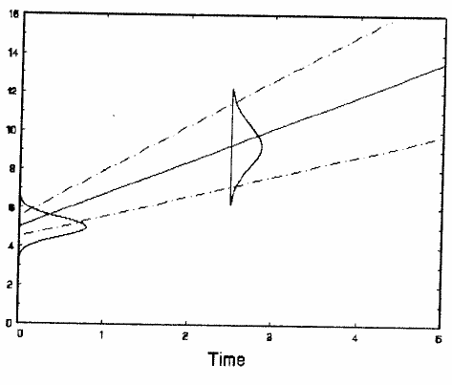
Centering explanatory variables
Source: Hedeker and Gibbons, Longitudinal Data Analysis. Wiley & Sons 2006, p. 60
https://www.wiley.com/en-nl/Longitudinal+Data+Analysis-p-9780471420279
Inclusion is permitted according to the agreement with the publisher.

Slide 30
Centering explanatory variables
Take Reisby data, center time (week 2.5 becomes 0 point)
for sake of simplicity, using model with just fixed effect of time, random effects for intercept and time

Slide 31
Centering explanatory variables
Parameter estimate | Model 1 (time not centered) | Model 2 (time centered)
Fixed: intercept | 25.95 | 20.01
Fixed: time | -2.38 | -2.38
Random: intercept (s.d.) | 4.25 | 3.65
Random: slope of time (s.d.) | 1.46 | 1.46
Random: corr (int-slope) | -0.582 | 0.322
Residual (s.d.) | 3.49 | 3.49
Estimates of intercept, variation of random intercepts and correlation rand int-slope all changed!

Slide 32
Linear mixed effects models with polynomial terms
Instead of linear trends over time, it is quite possible to observe non-linear trends (think of children’s growth, for instance)
There are many non-linear models that can be used within mixed models (beyond the scope of this course)
It is possible to fit polynomials as part of a “linear” mixed model

Slide 33
Example: Herpes Antibody Levels
45 children suffering from
solid lump tumour (N=18)
leukemia (N=27)
Measurements of antibody levels to a herpes virus taken during hospital visits for courses of chemotherapy
Duration: 1 mo - 3 yrs (median 12 mo)
Intervals between measurements differed per child
Questions:
are antibody levels affected by chemo?
if so, is change related to cancer type?

Slide 34
Linear mixed effects models with polynomial terms

Slide 35
Linear mixed effects models with polynomial terms

Slide 36
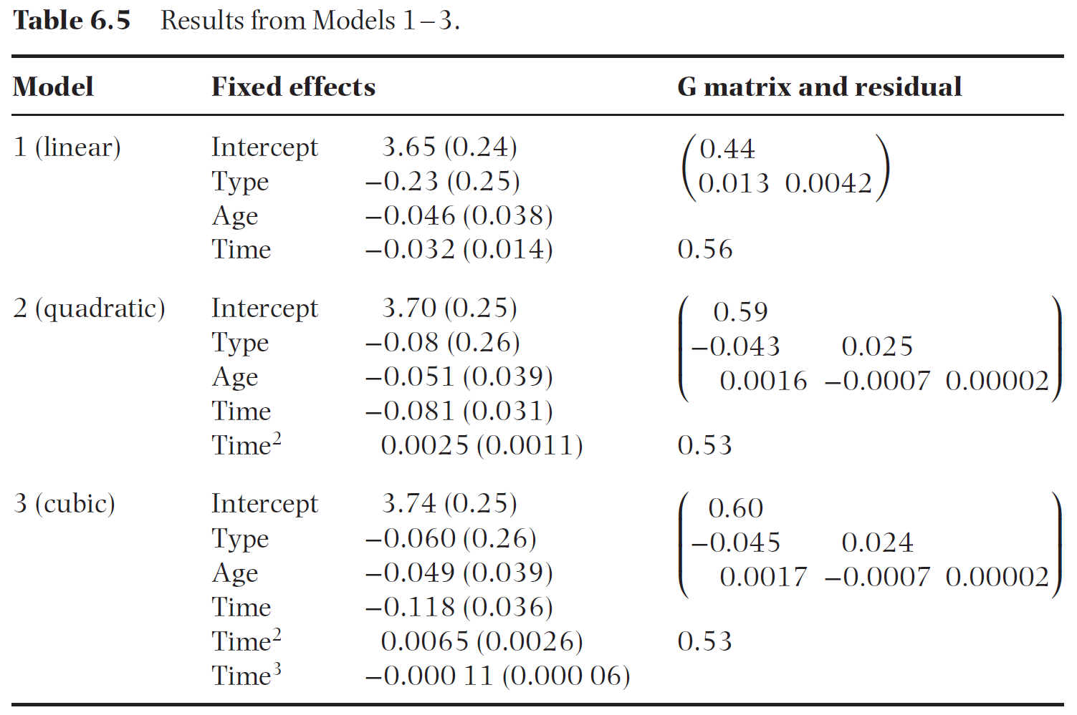
Linear mixed effects models with polynomial terms
Source: Brown & Prescott, Applied Mixed Models in Medicine, 3nd Edition. Wiley, 2015, p. 272

Slide 37
Other possibilities for nonlinear trends
Orthogonal polynomials
Natural cubic splines
Nonlinear mixed models

Slide 38
Three-level models
So far: two levels
children within schools, patients within hospitals
measurements within individuals over time
What about three levels?
children within classrooms within schools
longitudinal measurements within patients within hospitals

Slide 39
Analyzing three-level models
Variance at 3 levels
random effects (which??) at 2 levels
Variables measured at 3 levels?
main effects
“cross-level” interactions (SES of school * SES of child, gender of teacher * gender of child)
Think carefully about design
possible sources of variation
effects at lower level that could possibly differ at higher level
teacher-level variables (gender, experience) could have different effects at different schools
child-level variables (gender, entrance exam score) could have different effects in different classrooms or at different schools
Think about research question: simplicity vs generalizability

Slide 40
Example three-level data
Monday lab: multi-center hypertension trial: 27 centers, 193 patients, 4 post-randomization DBP
Sources of variation:
centers:
may serve different populations, with (on average) higher or lower BP
patients:
patients vary greatly in their blood pressure levels
age, gender, baseline BMI, treatment
patients may vary (greatly?) in trend over time
measurements in time:
BP varies considerably from moment to moment, day to day within individuals
stress level, tx adherence, BMI at the moment

Slide 41
Example three-level data
Design:
randomized trial, so interest in tx & tx*time
hospital-level variables: none provided
patient-level variables: treatment
measurement (time)-level variables: none provided
Fixed effects:
(intercept,) time (linear or categorical?), tx, tx*time
baseline DBP (why?)
Random effects?
differences in avg DBP among centers → random intercept per center
difference in tx effect per center? → random tx per center (tricky!!)
difference in time trend per center? → random time trend per center
differences among patients → random intercept (& time trend) per patient

Slide 42
Summary technical issues MM
Model building better done in protocol
Otherwise: use LRT or AIC to build random part of model, then to simplify fixed part of model
Use ML estimation for likelihood-based tests
Use REML estimation for presenting results
Some model assumptions (linearity, normality of res) can be checked
Centering explanatory variables has effect on interpretation of several parameters
“Linear” mixed models may also include polynomials
3+ levels also possible (complicated, but possible)

